Slide 1

GSoC 2025 Lightning Talk
Presented by Vidisha Gawas
Google Summer of Code

Slide 2
Who Am I?
Vidisha Gawas, from Maharashtra,India
Final Year Student at MITM
Computer Science Engineering
Current role: Open Source Contributor at ScalaCenter
I first discovered Scala Center while going through the GSoC organizations list.
Since I was already interested in functional programming and JVM-based languages,
Scala Center immediately stood out to me.
Grateful for community support and growth!

Slide 3
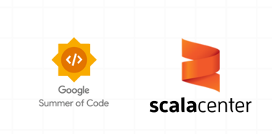

Discovering GSoC & Scala Center
My first encounter with Google Summer of Code and the Scala Center opened up a world of possibilities. It was clear that this program offered a unique opportunity to contribute to impactful open-source projects.
My chosen project, Scaladex: Support for Compiler Plugins, stood out to me as the perfect blend of my passion for Scala and my interest in advancing developer tooling. The opportunity to contribute to Scaladex not only deepens my understanding of the Scala ecosystem but also allows me to work on infrastructure that directly benefits the community by making compiler plugins more accessible and discoverable.
Our Mission:
To make LLM applications debuggable, observable, and scalable, leveraging Scala-first principles for robust development.

Slide 4
From First Trace to Full Demo: My Contributions
Compiler Plugin Integration
Ecosystem Reliability
Designed plugin categorization for better organization
Ensured compatibility handling across Scala versions
Strengthened error prevention with validation checks
Added support for indexing Scala compiler plugins in Scaladex
Improved discoverability of compiler plugins within the ecosystem
Enabled version-aware search and metadata enrichment

Slide 5
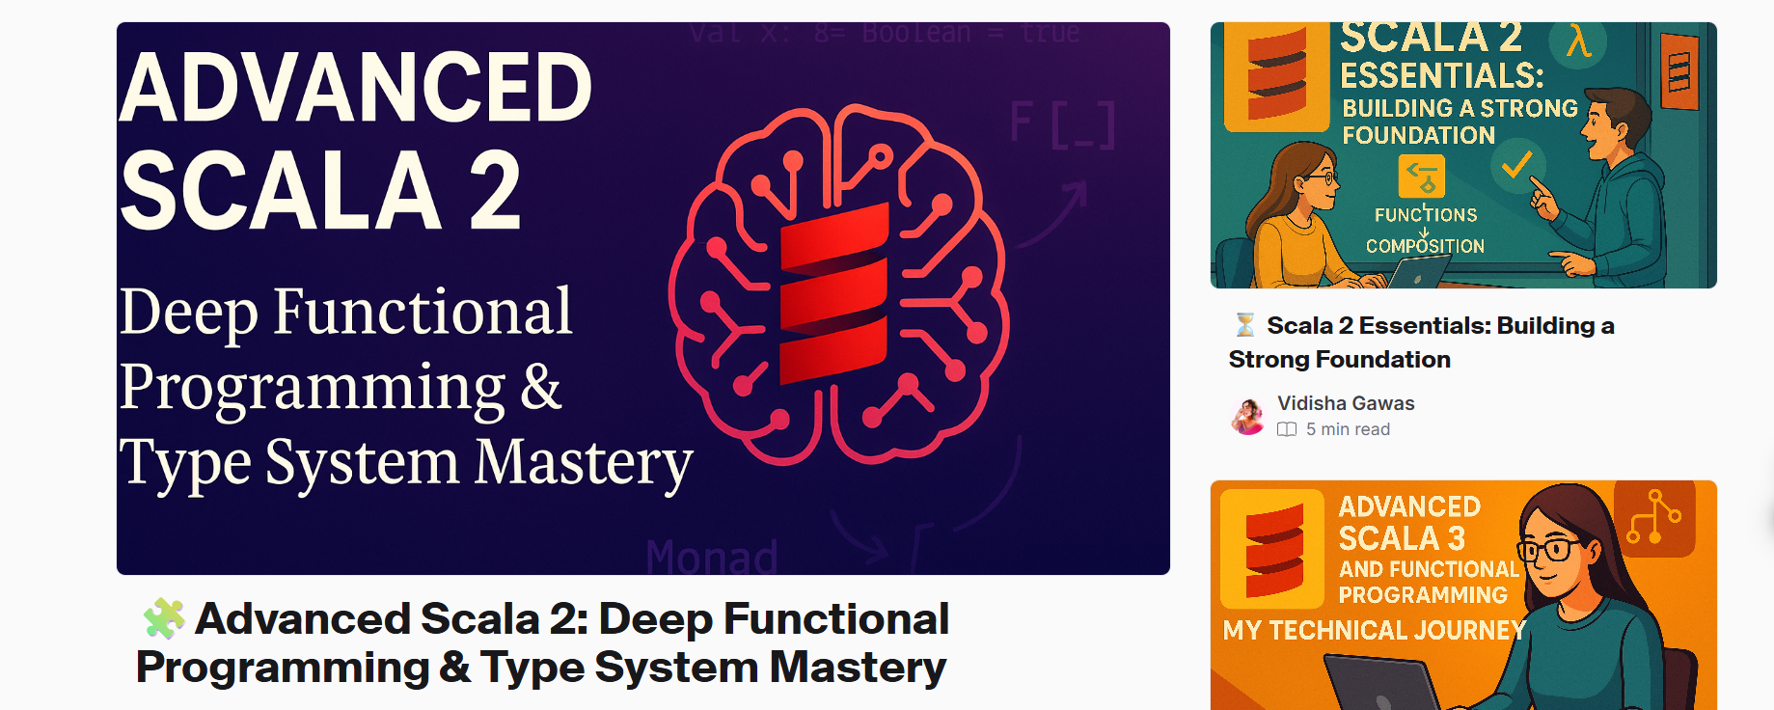
The Broader Impact: Open Source & Community
These are some of the blogs I have written while learning from the Rock The JVM courses

Slide 6
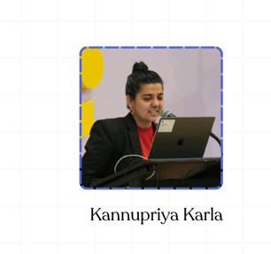
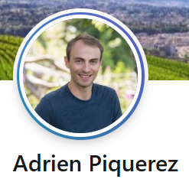
Thank You!
"From learner to contributor – I am profoundly grateful for this incredible journey."
I would like to sincerely thank my mentors for their constant guidance and support throughout this journey. Your insights, encouragement, and feedback not only helped me navigate challenges but also deepened my understanding of the Scala ecosystem.
I truly appreciate the time and effort you dedicated to mentoring me, and I am grateful for the opportunity to learn from you. This experience has been invaluable, and I look forward to carrying these lessons forward in my future contributions.

